Slide 1
Teaching kids real math
Conrad Wolfram + Dan Meyer

Slide 2
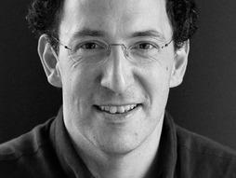
Conrad Wolfram
Runs the worldwide arm of Wolfram Research, the mathematical lab behind the cutting-edge knowledge engine Wolfram Alpha
Founder of ‘computerbasedmath.org’
Younger brother of Stephen Wolfram

Slide 3
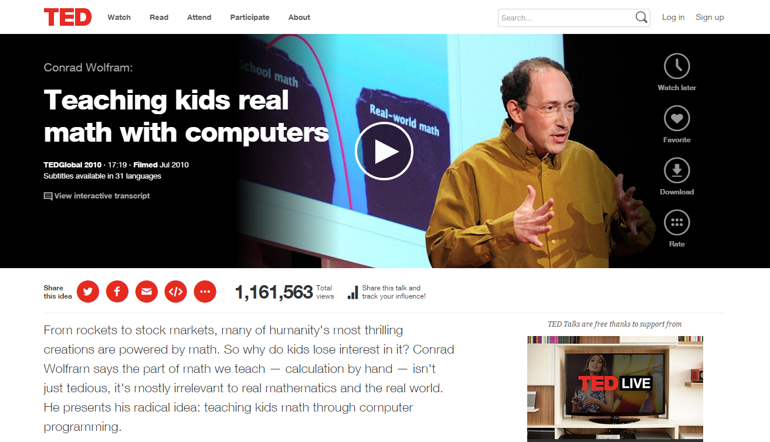

Slide 4
Problems
Kids
Governments
Teachers
Math is popular … just not in education

Slide 5
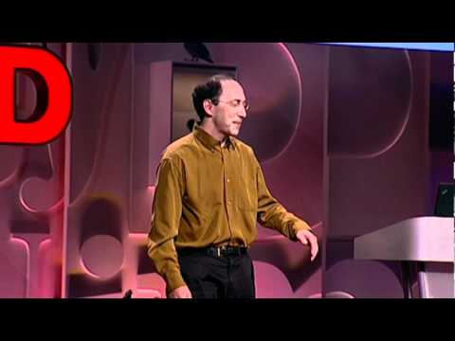
Math in real world vs. in schools

Slide 6
Why teach math?
Technical jobs
For living
Logical thinking

Slide 7
What is math?
Posing the right question
Real world → Math formulation
Computation
Math formulation → Real world verification
Math ≠ Calculating
Math >> Calculating

Slide 8
Common objections
Get the basics first
Computers dumb down math
Hand-calculating procedure teach understanding

Slide 9

Computerbasedmath.org
Estonia is moving toward it!

Slide 10
Dan Meyer
http://blog.mrmeyer.com/

Slide 11
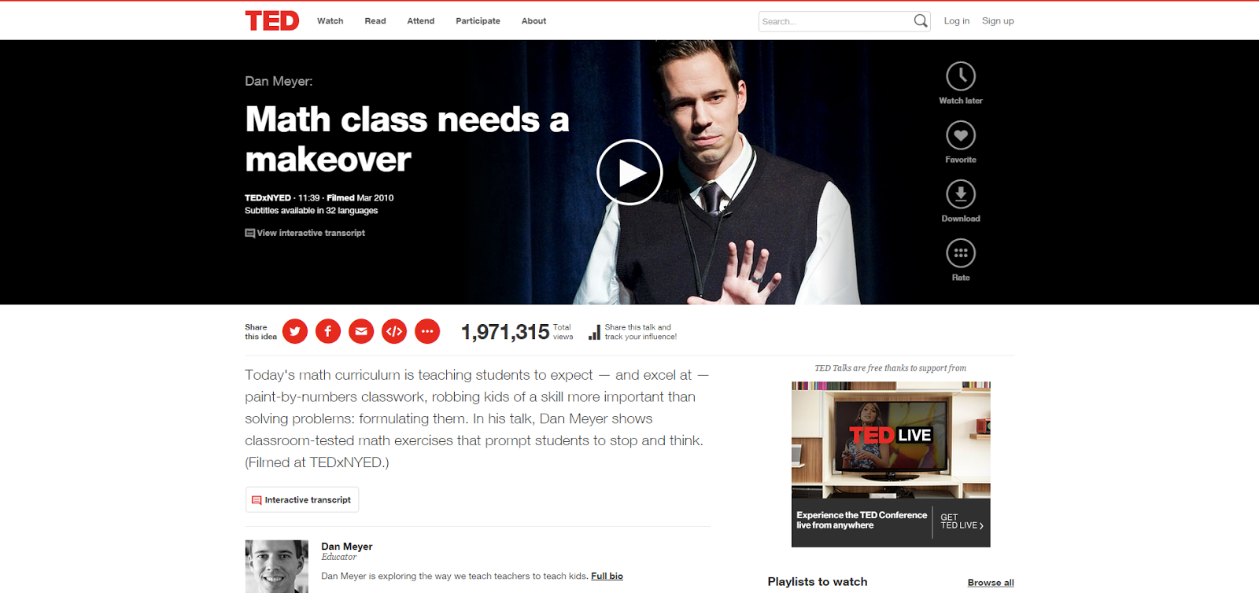

Slide 12
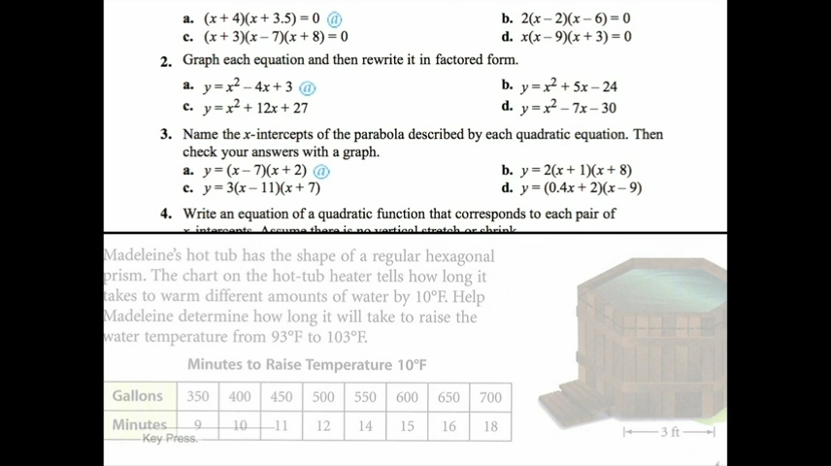
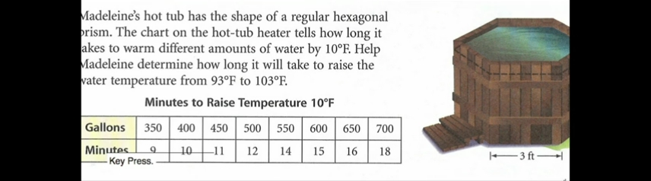
Math Education

Slide 13
Students…
의지가 없음
인내심이 부족함
기억하지 못함
말로 된 문제를 싫어함
공식을 좋아함

Slide 14
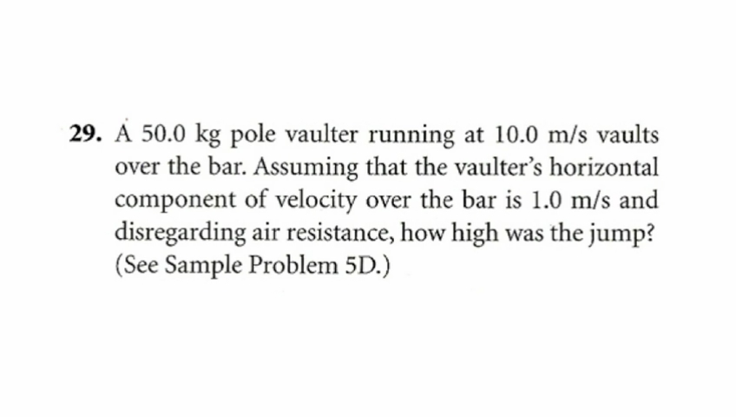
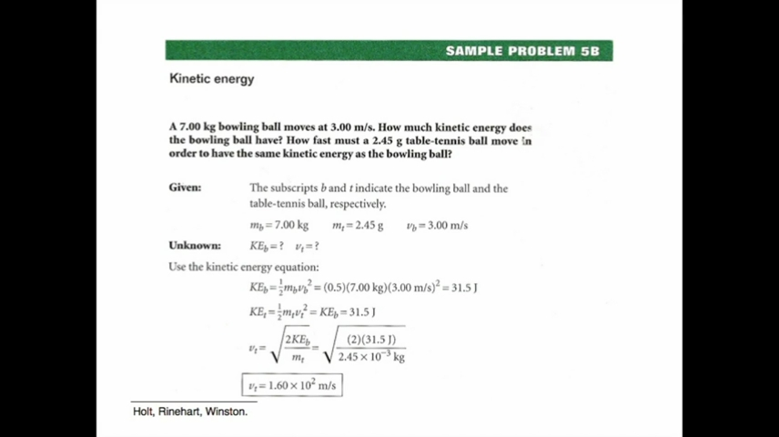
So what’s the problem?

Slide 15
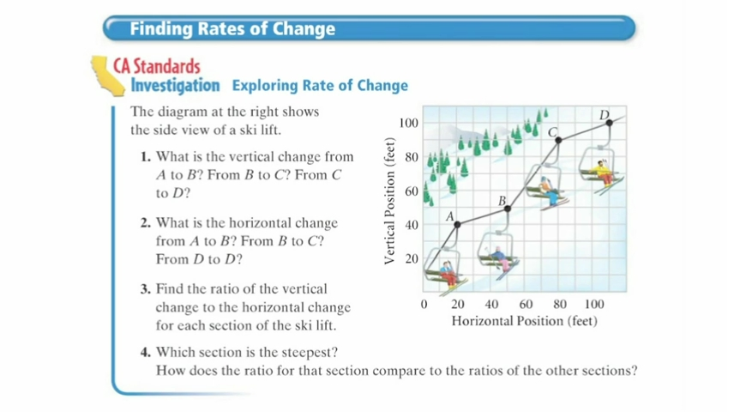

Slide 16
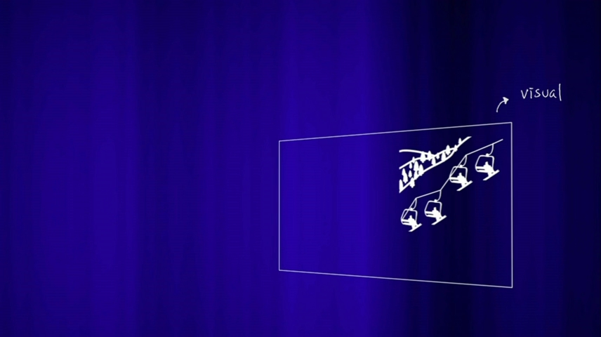
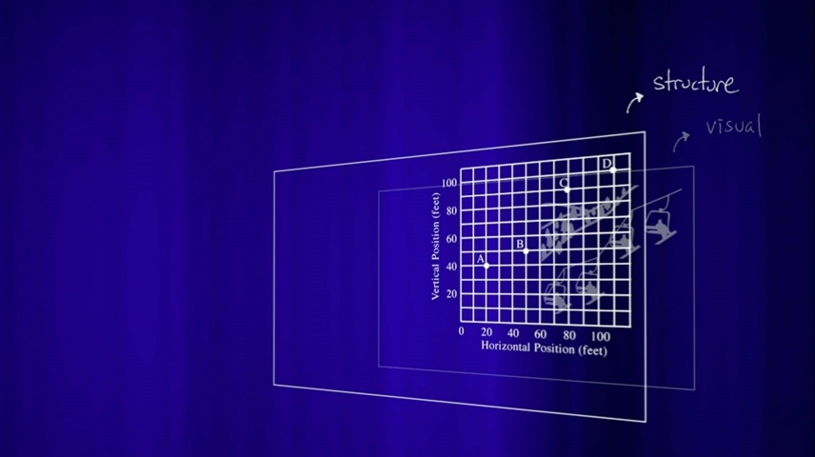
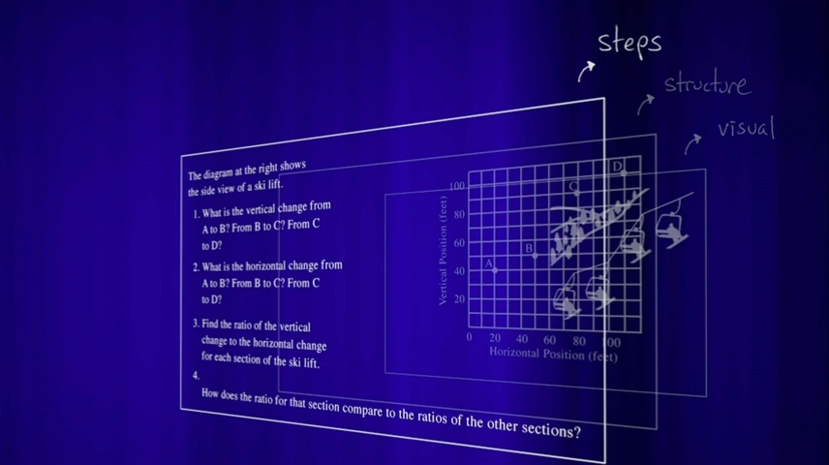
As is

Slide 17
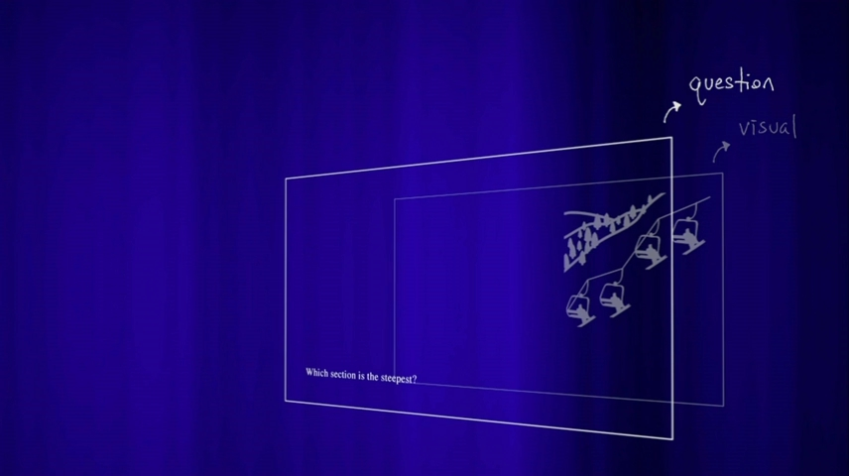
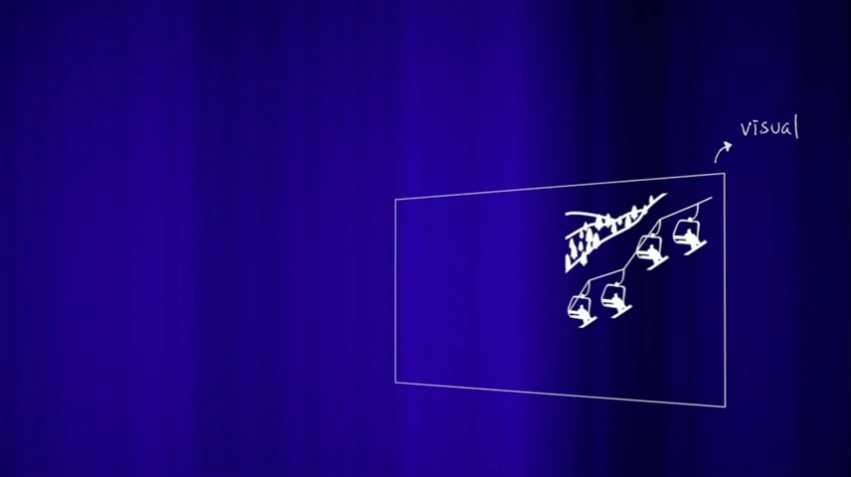
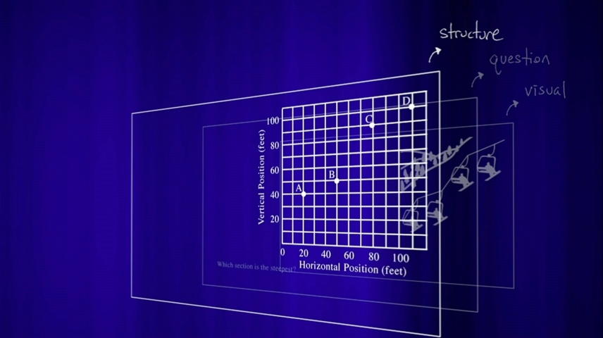
To be
Math serves conversation

Slide 18
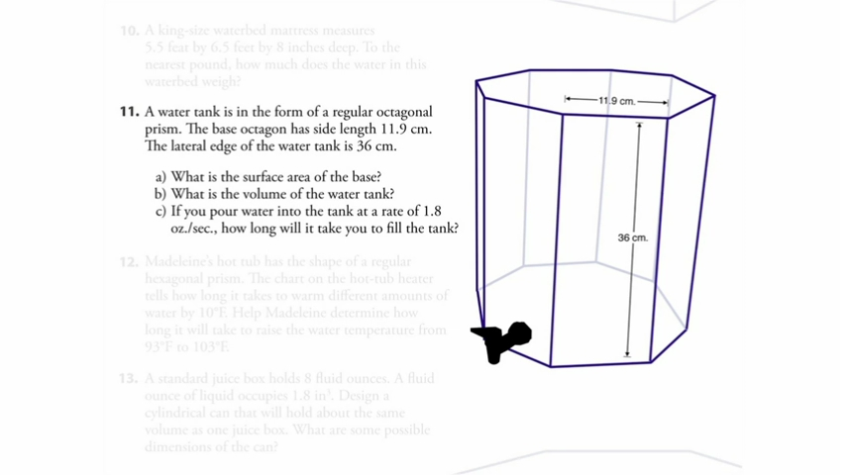
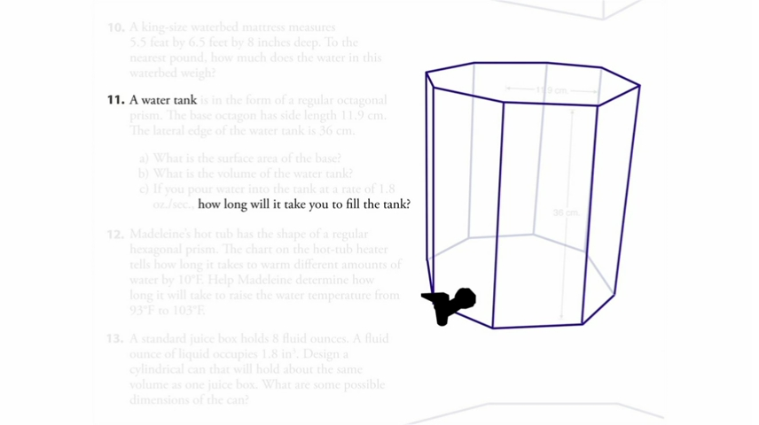

Slide 19
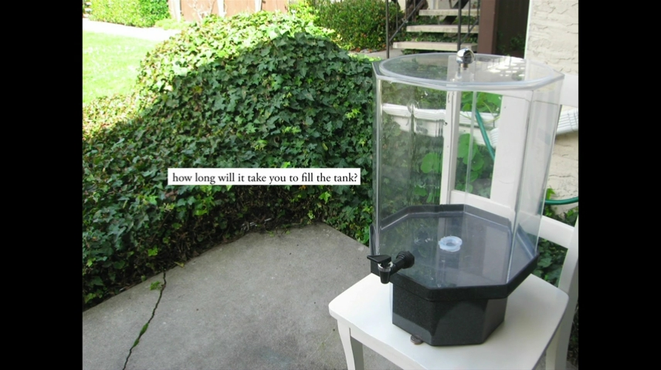

Slide 20
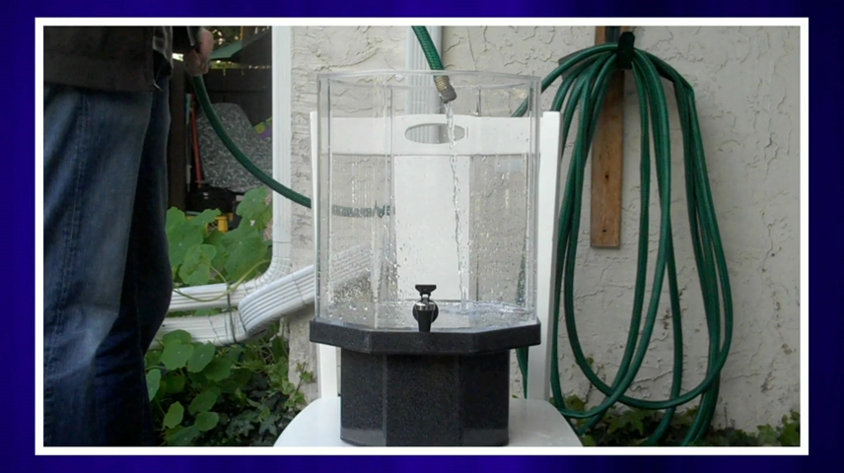

Slide 21
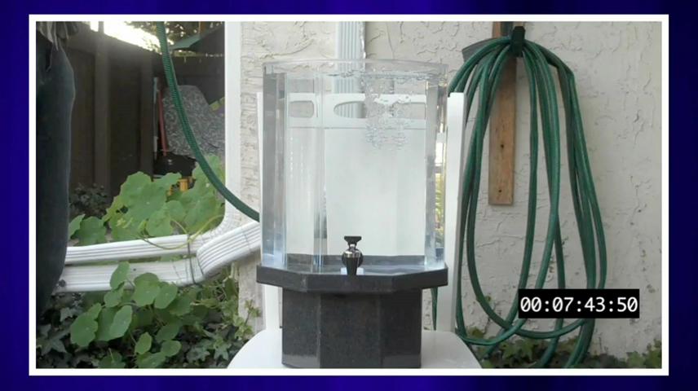

Slide 22
“The theoretical models that always work out in the answer key in the back of a teacher's edition, that's great, but it's scary to talk about sources of error when the theoretical does not match up with the practical. But those conversations have been so valuable, among the most valuable.”
“We're no longer averse to word problems,because we've redefined what a word problem is. We're no longer intimidated by math, because we're slowly redefining what math is.”

Slide 23
Suggestion
Use multimedia
Encourage student intuition
Ask the shortest question you can
Let student build the problem
Be less helpful

Slide 24
마치며..
문제를 찾는 즐거움
문제를 느끼는 즐거움
문제를 푼 사람들에 대한 감사

